Slide 1
Software Testing, Input Files, Structures & Unions
Lecture 6A

Slide 2
TESTING

Slide 3
Testing Your Software
Software sometimes (hardly ever) doesn’t work correctly the first time you write it.
  Compile errors
  Logic errors
  Misunderstood specifications
Important to recognize your program isn’t running correctly so
  (1) you can fix it
  (2) you don’t embarrass yourself

Slide 4
Some Software Bugs
https://www.youtube.com/watch?v=AGI371ht1N8
https://www.youtube.com/watch?v=tWc4gGMQ3hQ

Slide 5
Test Cases
Testing your software should be a systematic process
Create test cases:
  Explain what you hope to accomplish with this test case
  Specific input you plan to use
  Output or behavior you expect to observe with this input
  Doesn’t have to be extensive

Slide 6
Some Inputs from My P3 Test Suite
123456 Have per credit fee right
for resident undergrad?
y [resident]
y [undergraduate]
1
<156>
654321 Have per credit fee right
for resident grad?
y [resident]
n [undergraduate]
1
<368>
999998 Have per credit fee right
for non-resident undergrad?
n [resident]
y [undergraduate]
1
<523>
000000 Have per credit fee right
for non-resident grad?
n [resident]
n [undergraduate]
1
<576>
320044 Have verified max credits
right for resident undergrad?
y [resident]
y [undergraduate]
18
<2808>
…
<999999>
3 graduate students served
2 undergraduates served

Slide 7
Approaches to Testing
Black Box
  Software is viewed as a black box which transforms input to output based on the specifications of what the software is supposed to do
Glass Box
  Understand how the program is written and exploit this knowledge to identify things to test

Slide 8
Black Box Testing
Divide the input domain into Equivalence Classes such that the program can reasonably be expected to behave the same for all points within a class
  One equivalence class is ResidentUndergrad – you expect the program to multiply number of credits by $156
  Another equivalence class is ResidentGrad>12 - you expect the program to multiply number of credits >12 by 234 and add 4,416.

Slide 9
Glass Box Testing
For A Test Case To Detect A Fault ...
  there has to be a fault in the code
  the fault has to be executed
  a state error has to be created
  the state error must be recognized
first and foremost: the statement with the fault must be executed
Is there any code that has not yet been executed?

Slide 10
INPUT FILES

Slide 11
Redirecting stdin
We can redirect stdin from a file:
    ./a.out < filename
All or nothing – can’t get some data from keyboard and some from file
Pretty clunky when the program is written to be partially interactive since prompts, messages, etc. are still sent to stdout

Slide 12
Can read data directly from a file
Text file consisting of data values – probably one per line
Text can be any sort of character

Slide 13
A Text File Containing Data
ada:~/Ccode> cat data
123
980
234
555
127
320
ada:~/Ccode>

Slide 14
Accessing a Text File from C
Establish a file pointer to represent the file in the program (uses stdio.h)
  FILE *filePointer;
  filePointer = fopen(“data”,”r”);
  …
  fclose(filePointer);

Slide 15
Reading from a Text File
void main(void)
{
FILE *filePointer;
int dataValue;
filePointer = fopen("data","r");
printf("Opening File\n");
fscanf(filePointer,"%d",&dataValue);
printf("%d\n",dataValue);
printf("Closing File\n");
fclose(filePointer);
return;
}

Slide 16
Checking for End Of File (EOF)
stdin.h defines a constant EOF to be -1
If fscanf tries to read a data item and there is nothing left to read, it will return a -1 (EOF)
Typical pattern:
while(fscanf(fP,"%d\n",&dataVal)!=EOF)

Slide 17
Processing the Entire File
void main(void)
{
FILE *filePointer;
int dataValue;
filePointer = fopen("data","r");
printf("Opening File %d\n",EOF);
while(fscanf(filePointer,"%d\n",&dataValue)!=EOF)
{
printf("%d\n",dataValue);
}
printf("Closing File\n");
fclose(filePointer);
return;
}

Slide 18
Specifying a File
filePointer = fopen("data","r");
defaults to current directory
you can add a path
fP = fopen("/u/warren/NB/gpas","r");
you can always find your current path using “pwd”

Slide 19

Good Luck!

Slide 20
STRUCTURES & UNIONS

Slide 21
Synchronizing Arrays
Often we want multiple types of data relating to a single object
We must maintain parallel arrays to keep the data synchronized
Walden | Thoreau | 1854 | 114634
Fahrenheit 451 | Bradbury | 1953 | 46118
Old Yeller | Gipson | 1956 | 35968

Slide 22
Parallel Arrays – related by a common subscript
#include <stdio.h>
void main(void)
{
char author[50][20]={{"Thoreau"},{"Bradbury"},{"Gipson"}};
char title[50][20]={{"Walden"},{"Fahrenheit 451"},
{"Old Yeller"}};
int year[50] = {1854,1953,1956};
int words[50] = {114634,46118,35968};
int i;
for(i=0;i<3;i++)
{
printf("%s wrote %s in %d\n",author[i],title[i],year[i]);
}
}

Slide 23
Structures
Allows you to have a single variable that can contain members of different types.
  struct bookinfo {
  char title[20];
  char author[20];
  int year;
  int wordCnt;
  }

Slide 24
A New User-Defined Data Type
A struct allows you to create a “new” aggregate data type:
  struct bookinfo newBook;
  strcpy(newBook.title,"Walden");
  strcpy(newBook.author,"Thoreau");
  newBook.year = 1854;
  newBook.wordCnt = 114634;
  printf("%s\n",newBook.title);

Slide 25
Structure Rules
Within a structure, all member names must be unique
The same member name can be used in different structures

Slide 26
Duplicate Member Names
struct bookinfo {
char title[20];
char author[20];
int year;
int wordCnt;
};
struct musicinfo {
char title[20];
char author[20];
int year;
int duration;
};
struct bookinfo myBook;
struct musicinfo myMusic;

Slide 27
An Array of structs
struct bookinfo {
char title[20];
char author[20];
int year;
int wordCnt;
};
struct bookinfo newBook[10];
strcpy(newBook[5].title,"Walden");
strcpy(newBook[5].author,"Thoreau");
newBook[5].year = 1854;
newBook[5].wordCnt = 114634;
printf("%s\n",newBook[5].title);

Slide 28
typdef
Makes the new data type more “natural”
typedef struct {
char title[20];
char author[20];
int year;
int wordCnt;
} bookinfo;
bookinfo newBook[10];

Slide 29
Reusing structs with .h files
structs can be put into a .h file so they can be reused among several programs
struct2.h:
  typedef struct {
  char title[20];
  char author[20];
  int year;
  int wordCnt;
  } bookinfo;

Slide 30
Using the .h File …
#include <stdio.h>
#include <string.h>
#include "struct2.h"
void main(void)
{
bookinfo newBook[10];
strcpy(newBook[5].title,"Walden");
strcpy(newBook[5].author,"Thoreau");
newBook[5].year = 1854;
newBook[5].wordCnt = 114634;
printf("%s\n",newBook[5].title);
}

Slide 31
Using an Array of structs in a Function
#include "struct2.h"
void printBook(bookinfo book[])
{
printf("FROM FUNCTION: %s\n",book[5].author);
return;
}
void main(void)
{
bookinfo newBook[10];
strcpy(newBook[5].title,"Walden");
strcpy(newBook[5].author,"Thoreau");
newBook[5].year = 1854;
newBook[5].wordCnt = 114634;
printBook(newBook);
}

Slide 32
Using a Pointer to an Array of structs
void main(void)
{
bookinfo newBook[10];
bookinfo *p;
strcpy(newBook[5].title,"Walden");
strcpy(newBook[5].author,"Thoreau");
newBook[5].year = 1854;
newBook[5].wordCnt = 114634;
newBook[6] = newBook[5];
p = &newBook[5];
printf("%s\n",(*p).title);
printf("%s\n",(*(p+1)).title);}
}

Slide 33
Why (*p)?
Member specification takes precedence over dereferencing
*p.title implies *(p.title) NOT (*p).title
When using pointers with structs, use ‘->’

Slide 34
Using -> with a struct pointer and a function
void printBook(bookinfo *book)
{
printf("FROM FUNCTION: %s\n",book-> author);
return;
}
void main(void)
{
bookinfo newBook[10];
bookinfo *p;
…
p = &newBook[5];
printBook(p);
}

Slide 35
Unions
Allow a given variable to take on several possible values
Polymorphic
Like a struct, but members share the same memory location

Slide 36
Using a union to generate a string
#include <stdio.h>
void main(void)
{
typedef union {
char aString[8];
int aNumber;
} grabBag;
grabBag a;
a.aNumber = 825373492;
printf("%d\n",a.aNumber);
printf("%s\n",a.aString);
}

Slide 37
How did we do this?
one integer = 4 bytes/one character = 1 bytes
Figure out the hex codes for each letter:
‘A’ = 41, ‘B’ = 42, ‘C’ = 43, ‘D’ = 44
What is the decimal value of 0X 41424344?
www.binaryhexconverter.com/hex-to-decimal-converter
1094861636
You’ll need to invert the letters since our architecture is little endian – least significant digit first

Slide 38
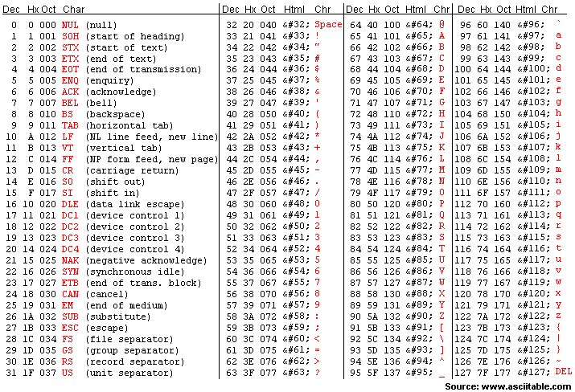
Standard ASCII Codes (0-127)

Slide 39
PROGRAM 6A

Slide 40
Program 6A
Re-implement your FRUPAL map as an array of structs – so each map cell is a struct containing a “visibility flag“ (0=not visible, 1=visible), a terrain identifier (0=meadow, 1=forest, 2=water,3=wall) and a content string (Tree, Boulder, Blackberry Bushes, Power Bar, Treasure Chest, Royal Diamonds, Hatchet, Axe, Chainsaw, Chisel, Sledge, Jackhammer, Machete, Binoculars, None). None indicates the Map Cell is empty.
Also add a map print function to the status command. Invisible map cells will be represented by an “XXX”, visible map cells that are empty will be represented by “000”, “111”, “222” or “333” corresponding to their terrain identifier. If the cell has content, instead display their terrain identified as “+0+”, “+1+”, “+2+” or “+3+” [IGNORE] and display the coordinates and content below the displayed map. While you should be using #define constants to specify the size of the map, use a 20x20 map for the version you submit. Note that you aren’t buying anything or dealing with obstacles just yet.
Finally, add a “secret” command “Z” that will display the map as above, but *all* cells will be visible.

